Slide 2
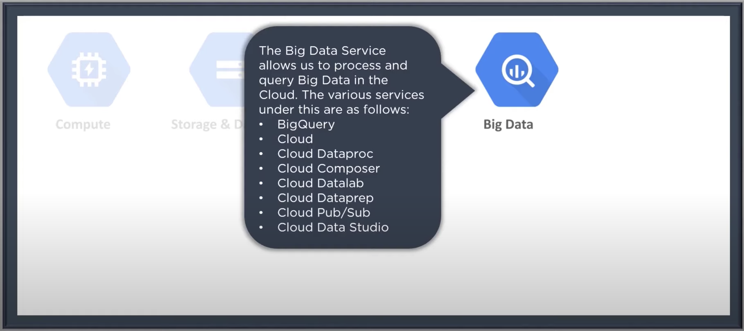
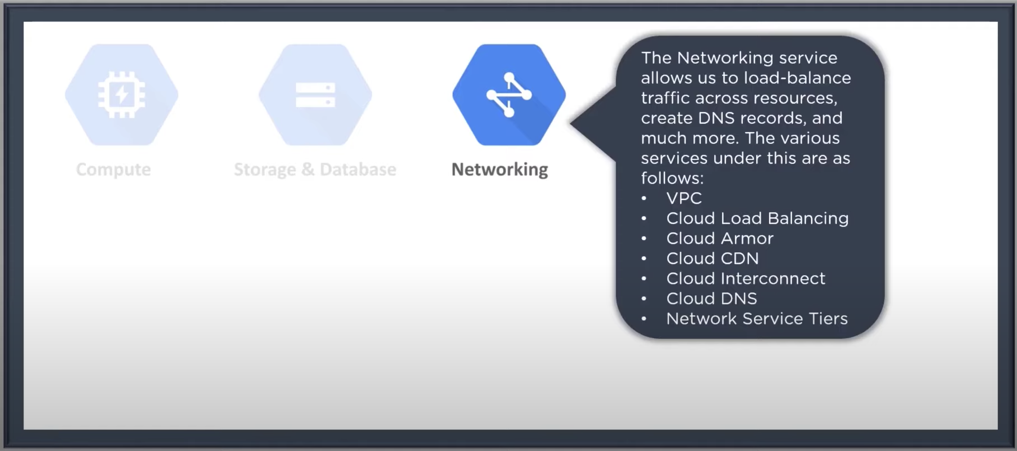
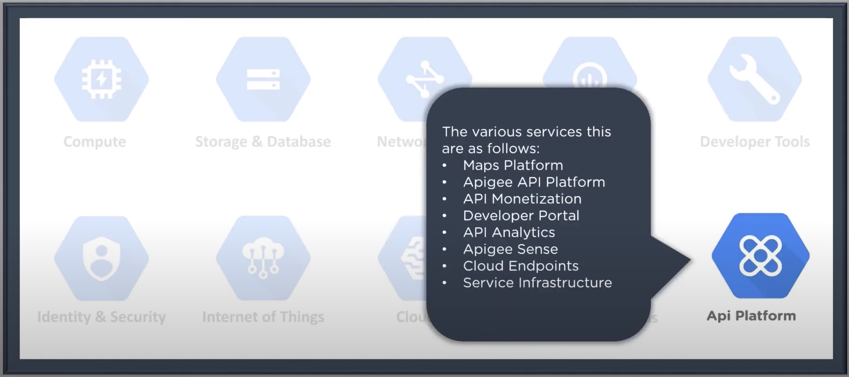
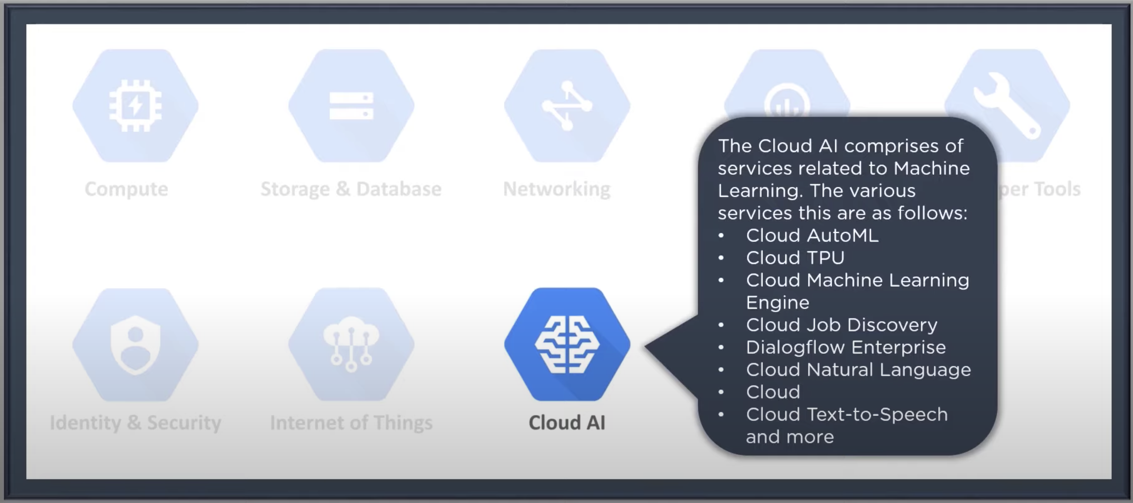
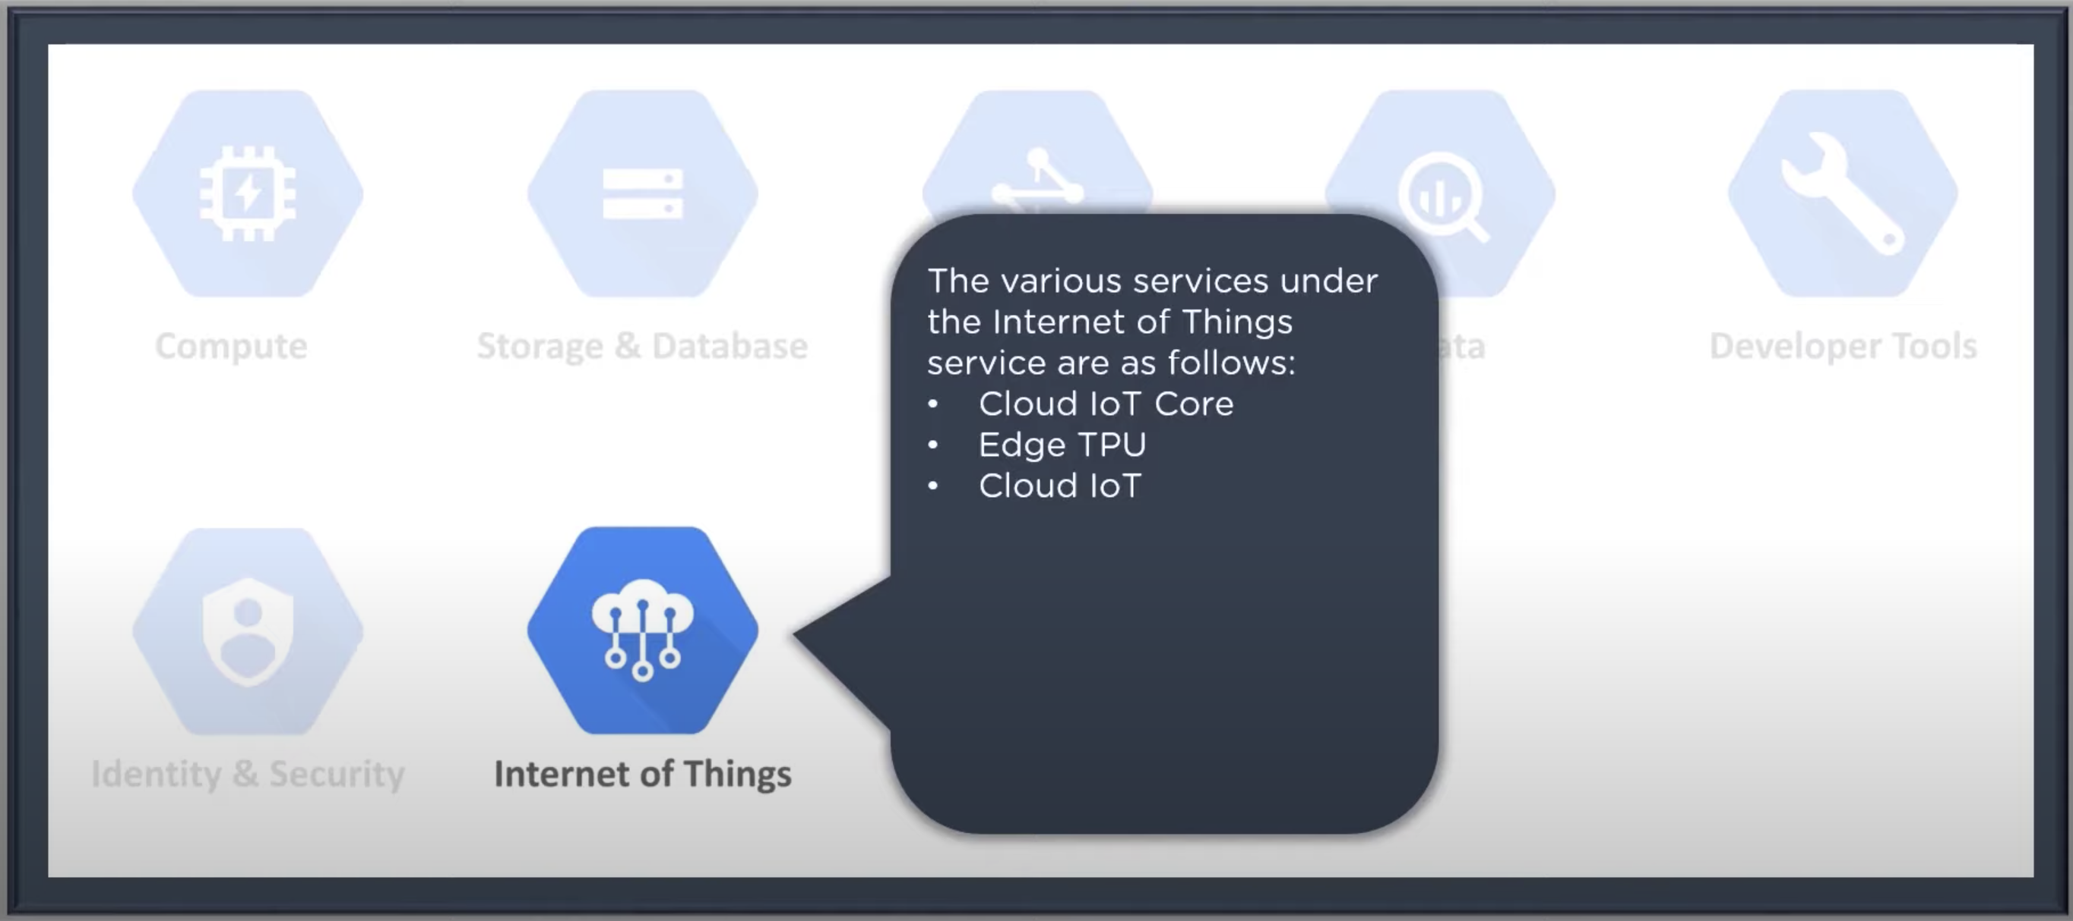
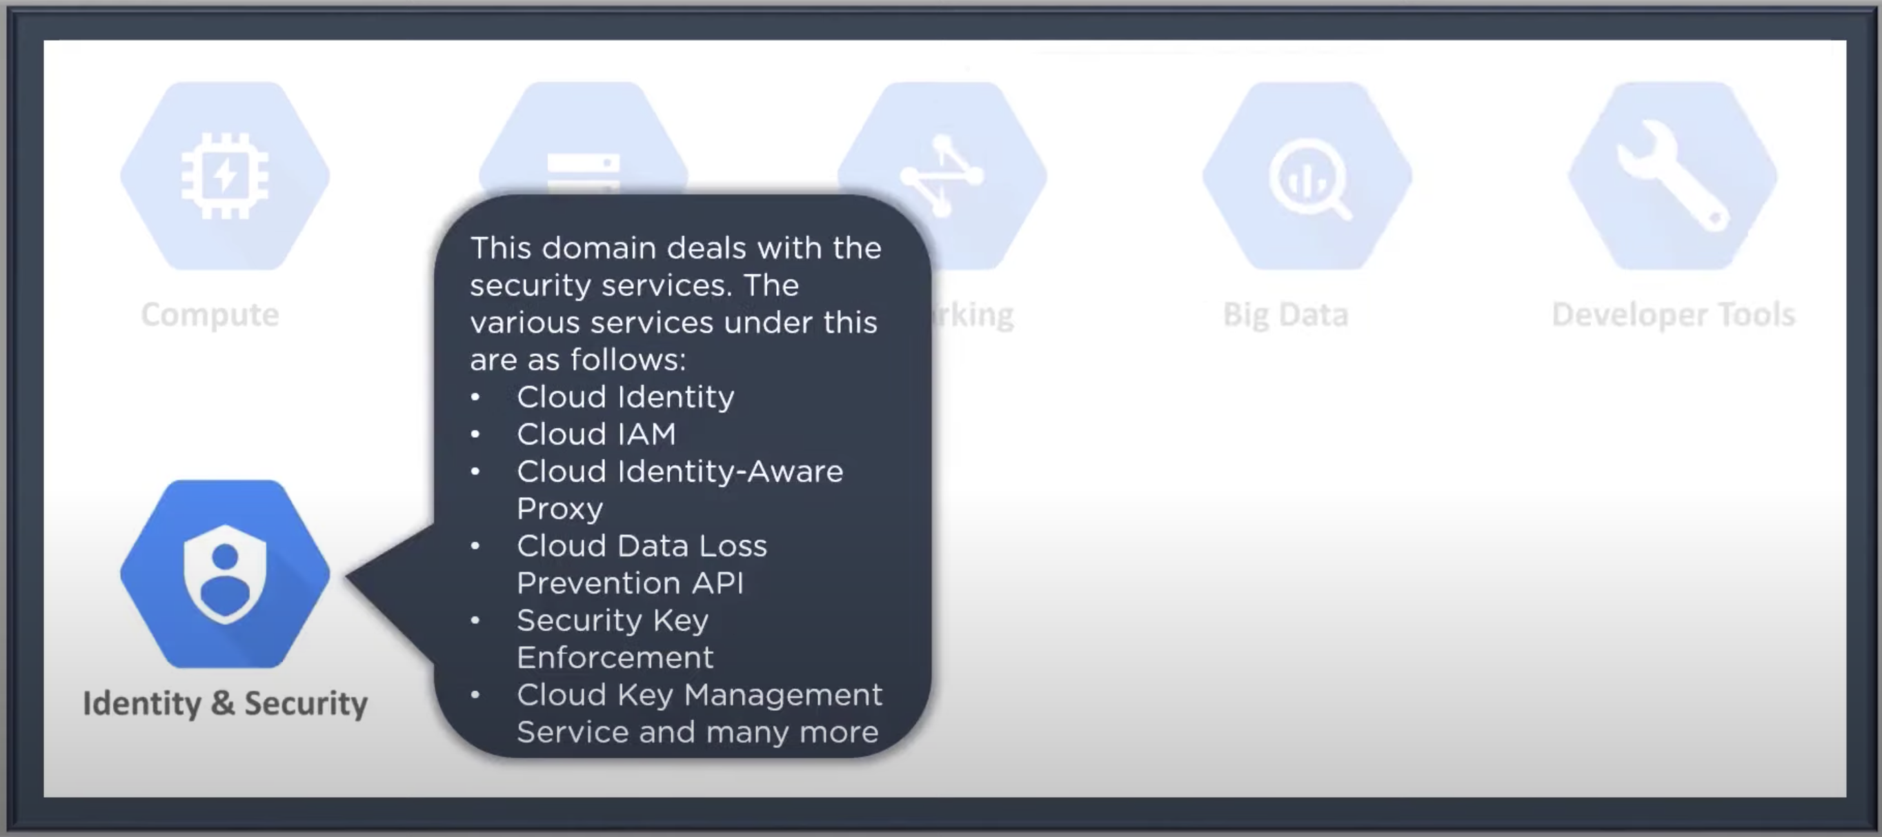
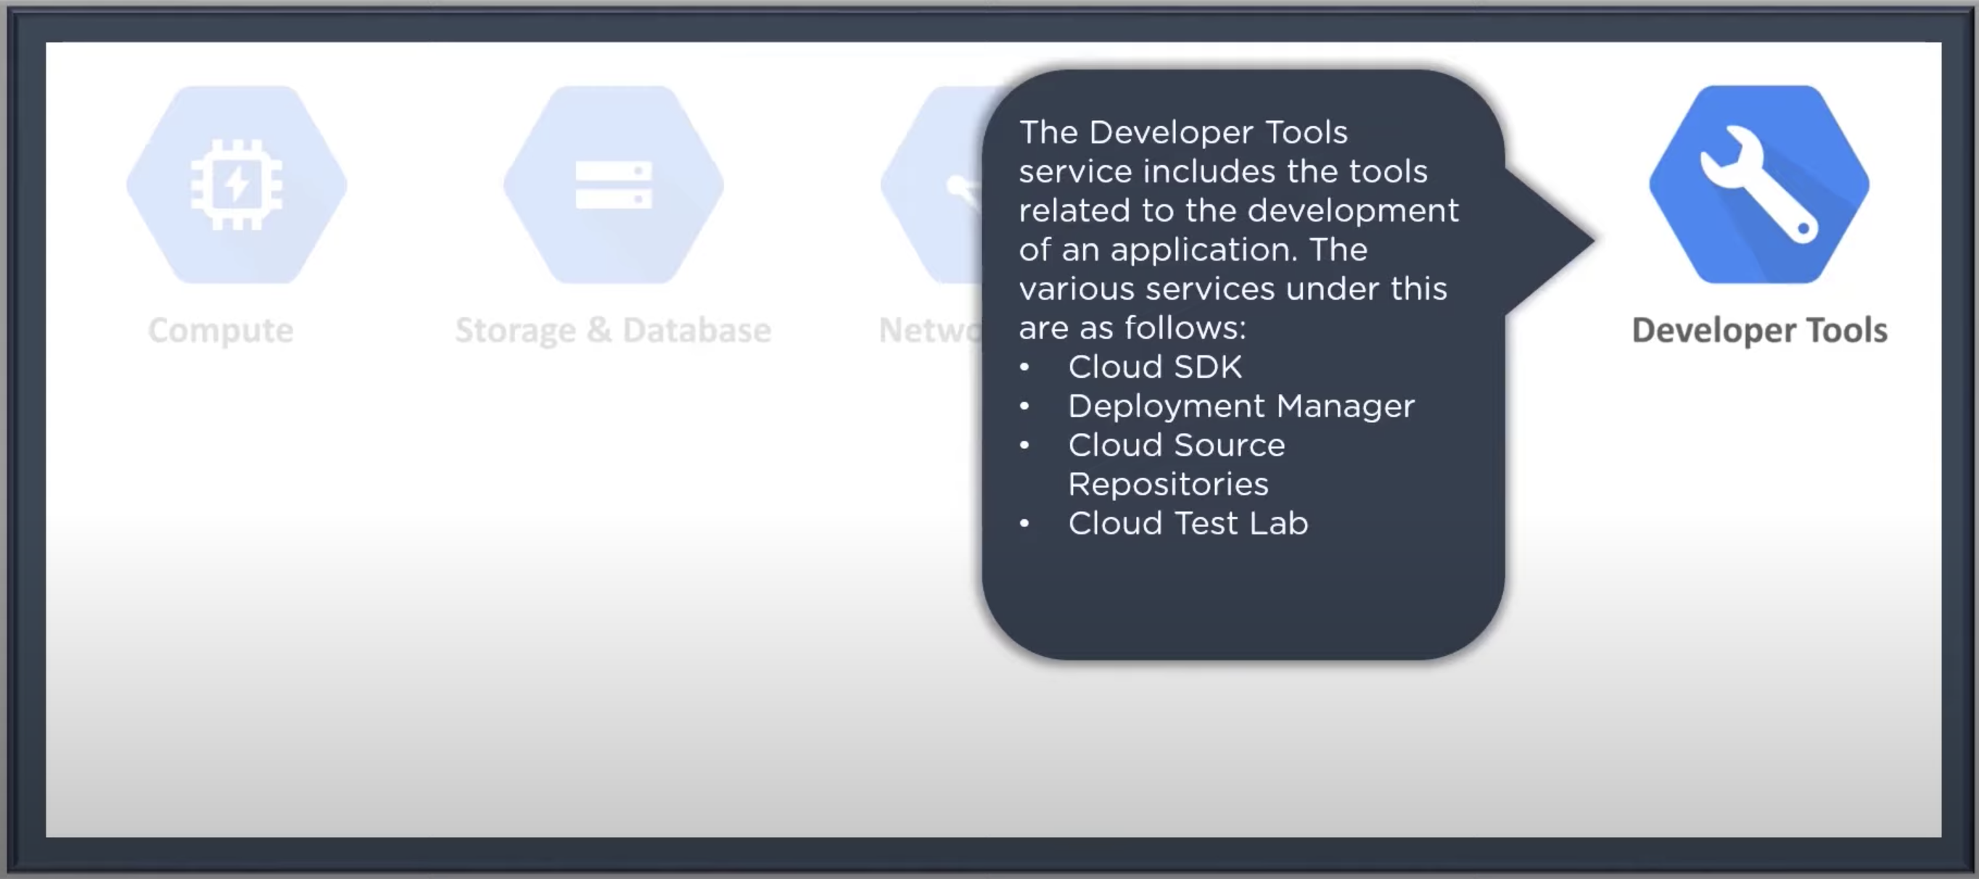
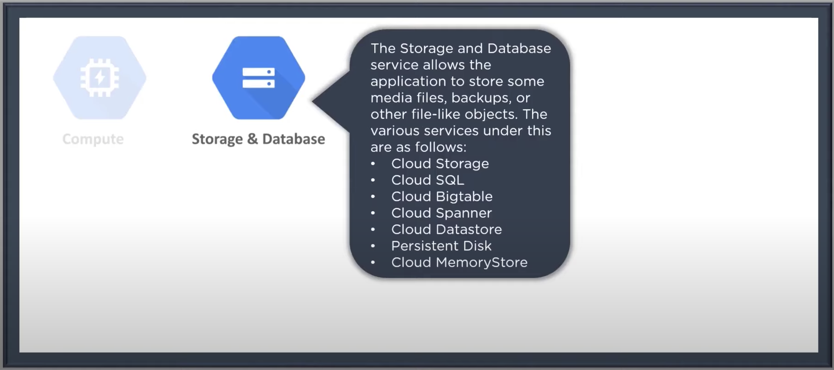
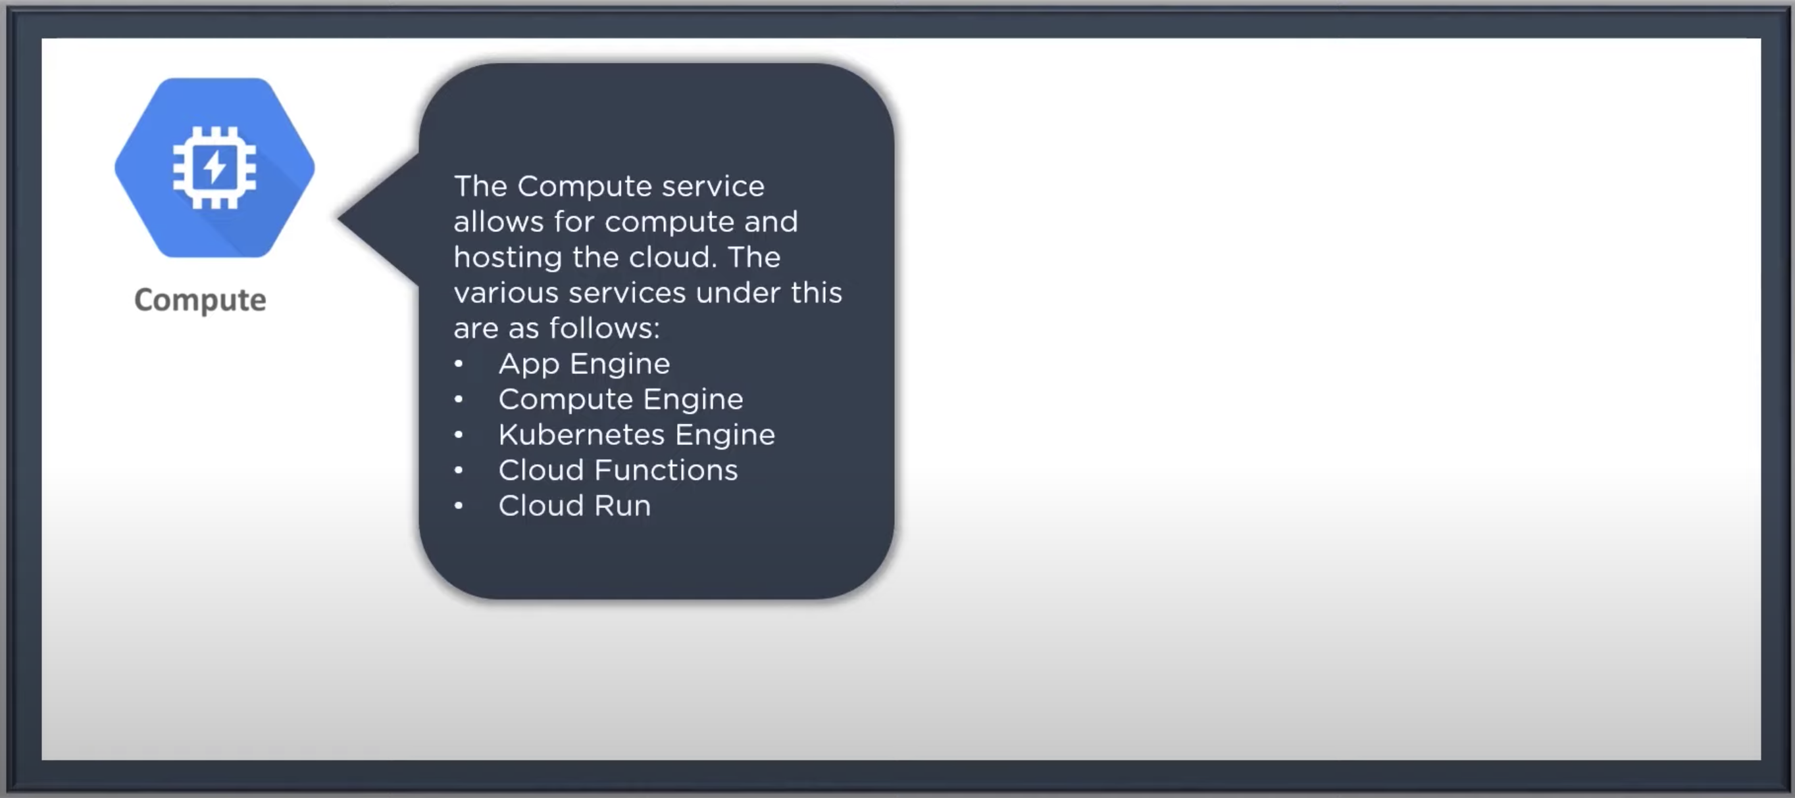
Google Cloud Platform Domains

Slide 3
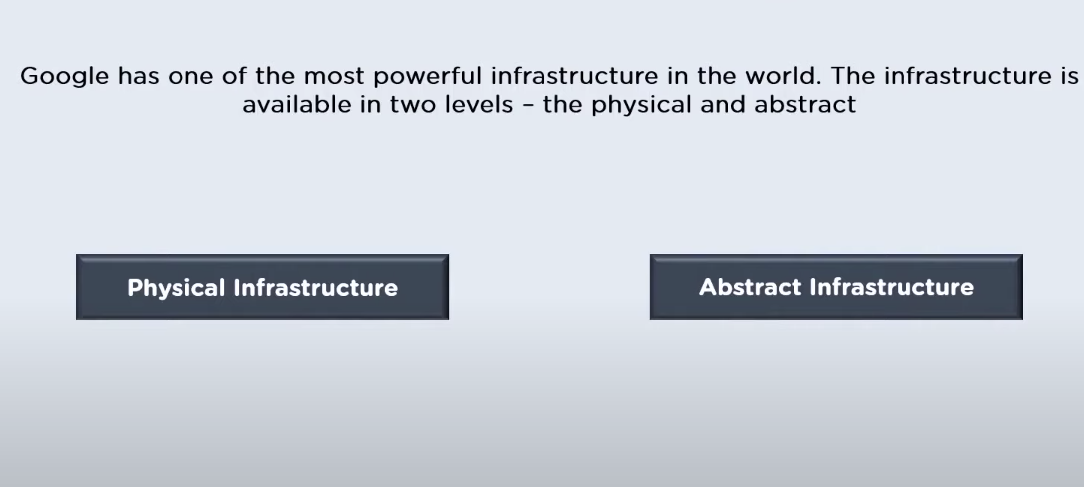
Google Infrastructure

Slide 4
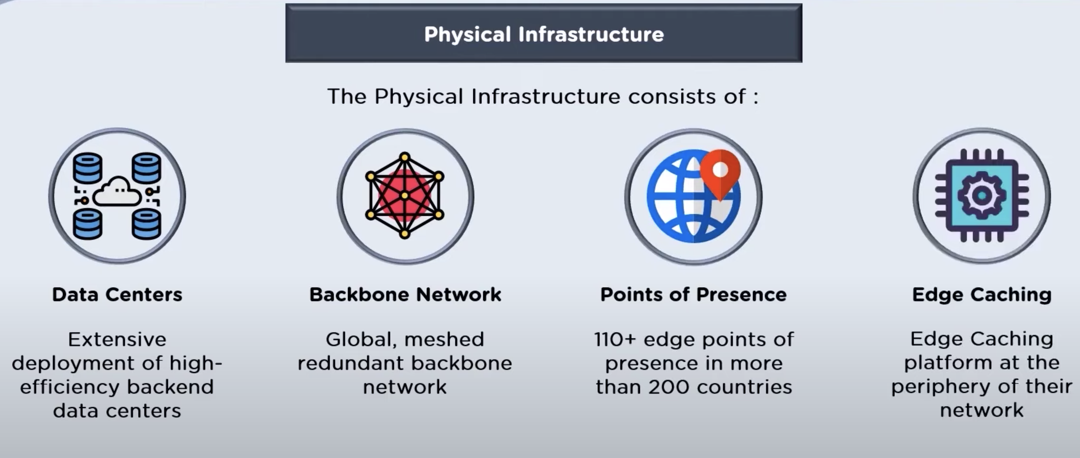
Google Infrastructure

Slide 5
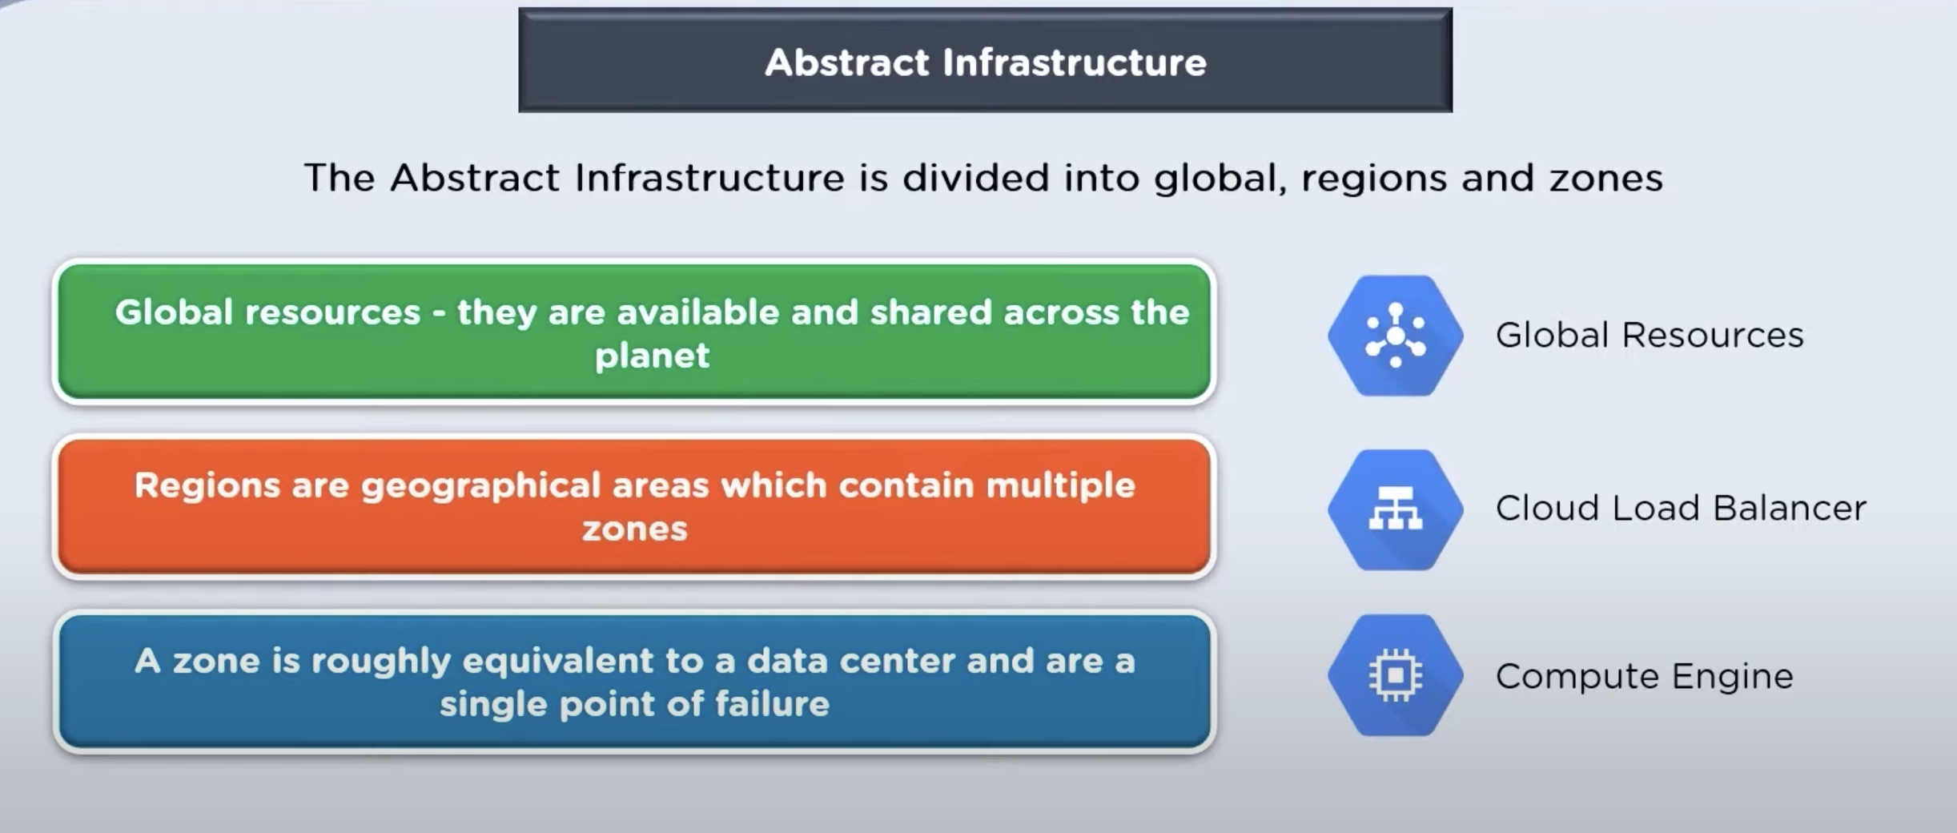
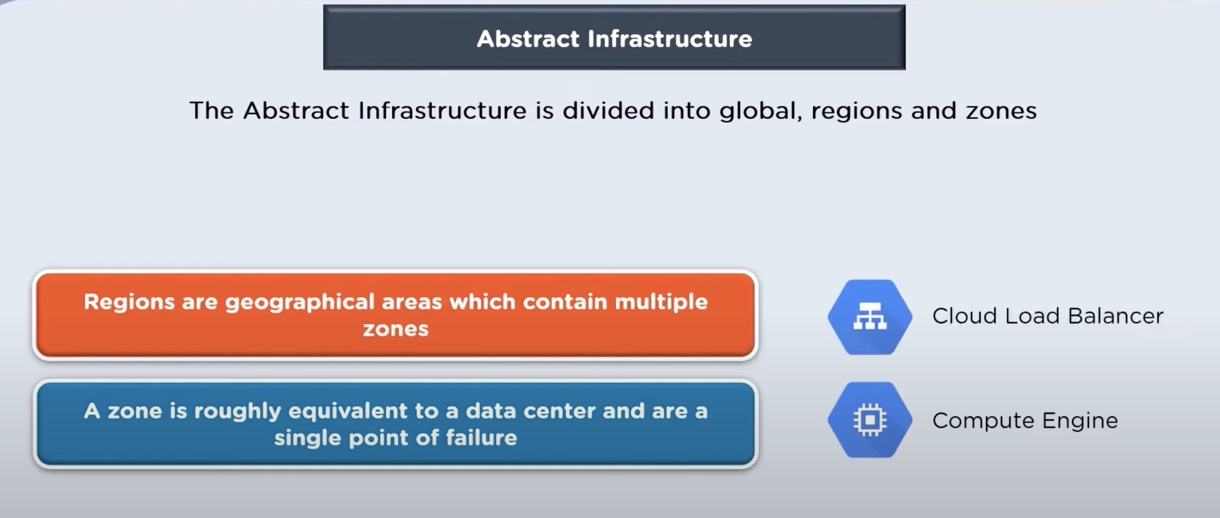
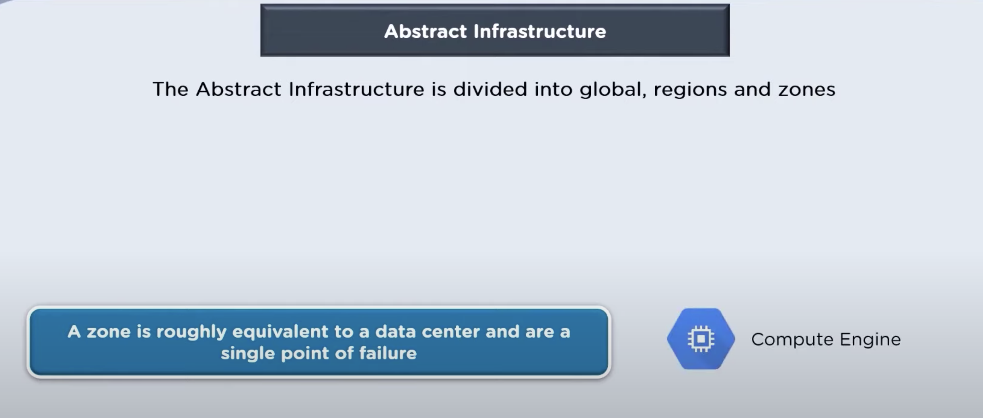
Google Infrastructure

Slide 6
Regions and Zones

Slide 7

Network cable

Slide 8
Compute Options
Cloud Functions
Your Code
App Engine
Cloud Run
Your Containers
Kubernetes Engine
Compute Engine

Slide 9
Google Compute Engine
IaaS
Runs Search Engine, Gmail, Youtube
High performance, Fault Tolerant & Scalable VMs
Can be built by standard or custom images
Amazon Elastic Compute Cloud
Virtual Machines

Slide 10
App Engine
App Engine Goal: Let developer focus on app code
No server to manager, scale up fast, scale down to zero
No patches/update
Traffic splitting
Amazon Elastic Bean Stack
Azure App Service

